Slide 1
Option Trading
Simulate Naked Put
11-24-2025
Microsoft Visual Code studio

Slide 2
ORATS Data
Etay helped me to download 15 minutes before the close daily data
Data includes Stocks and Options
$599 license for 10 years
Hosted FTP: orats.hostedftp.com
User: yuda.luz@gmail.com
Password: HM1

Slide 3
ORATS Data is downloaded as Zip:
ticker,cOpra,pOpra,stkPx,expirDate,yte,strike,cVolu,cOi,pVolu,pOi,cBidPx,cValue,cAskPx,pBidPx,pValue,pAskPx,cBidIv,cMidIv,cAskIv,smoothSmvVol,pBidIv,pMidIv,pAskIv,iRate,divRate,residualRateData,delta,gamma,theta,vega,rho,phi,driftlessTheta,extVol,extCTheo,extPTheo,spot_px,trade_date
A,A250221C00065000,A250221P00065000,152.46,2/21/2025,0.07945,65.00,0,0,0,0,85.80,87.68,88.70,0.00,0.00,1.30,0.000000,0.91716,1.834321,0.292869,0.000000,0.96525,1.930494,0.0436,0,0.000000,1.00000000,-0.00000000,0.00000000,0.00001000,0.05148244,-0.12117320,-0.00000027,0.40124231576919556,87.82001495361328,6.654162719896511e-16,0.00,1/23/2025
A,A250221C00070000,A250221P00070000,152.46,2/21/2025,0.07945,70.00,0,0,0,0,80.70,82.70,84.10,0.00,0.00,1.20,0.000000,0.90560,1.811199,0.292869,0.000000,0.87603,1.752053,0.0436,0,0.000000,1.00000000,-0.00000000,-0.00000000,0.00001000,0.05544263,-0.12117320,-0.00000029,0.4001282751560211,82.84735107421875,0.00000000000025600544904455513,0.00,1/23/2025
A,A250221C00075000,A250221P00075000,152.46,2/21/2025,0.07945,75.00,0,0,0,0,75.70,77.72,79.00,0.00,0.00,1.25,0.000000,0.81940,1.638797,0.292440,0.000000,0.81489,1.629770,0.0436,0,0.000000,1.00000000,-0.00000000,-0.00000000,0.00001000,0.05940282,-0.12117320,-0.00000031,0.3969932794570923,77.87393188476562,0.000000000029689029013013624,0.00,1/23/2025
A,A250221C00080000,A250221P00080000,152.46,2/21/2025,0.07945,80.00,0,0,0,3,70.70,72.74,74.00,0.00,0.00,1.25,0.000000,0.75300,1.506010,0.292074,0.000000,0.75103,1.502064,0.0436,0,0.000000,1.00000000,-0.00000000,-0.00000000,0.00001000,0.06336300,-0.12117321,-0.00000033,0.3943053185939789,72.90052795410156,0.0000000014965503281061387,0.00,1/23/2025
A,A250221C00085000,A250221P00085000,152.46,2/21/2025,0.07945,85.00,0,0,0,1,65.80,67.75,69.10,0.00,0.00,1.30,0.000000,0.70287,1.405744,0.291546,0.000000,0.69744,1.394882,0.0436,0,0.000000,1.00000000,0.00000000,-0.00000000,0.00001000,0.06732319,-0.12117321,-0.00000035,0.3904106914997101,67.9265365600586,0.00000004237214312752258,0.00,1/23/2025
A,A250221C00090000,A250221P00090000,152.46,2/21/2025,0.07945,90.00,0,0,0,3,60.80,62.77,64.00,0.00,0.00,0.30,0.000000,0.63172,1.263434,0.294502,0.000000,0.48163,0.963251,0.0436,0,0.000000,1.00000000,0.00000000,-0.00000000,0.00001000,0.07128338,-0.12117320,-0.00000037,0.41193652153015137,62.96293640136719,0.000004160307071288116,0.00,1/23/2025
A,A250221C00095000,A250221P00095000,152.46,2/21/2025,0.07945,95.00,0,1,0,3,55.80,57.79,58.90,0.00,0.00,0.30,0.000000,0.56462,1.129249,0.294299,0.000000,0.43837,0.876733,0.0436,0,0.000000,1.00000000,0.00000000,-0.00000000,0.00001000,0.07524356,-0.12117320,-0.00000039,0.4104810059070587,57.990272521972656,0.00004056164834764786,0.00,1/23/2025
A,A250221C00100000,A250221P00100000,152.46,2/21/2025,0.07945,100.00,0,0,0,3,50.80,52.81,54.00,0.00,0.00,1.30,0.000000,0.52224,1.044490,0.290065,0.000000,0.53325,1.066507,0.0436,0,0.000000,1.00000000,0.00000002,-0.00000009,0.00001011,0.07920375,-0.12117320,-0.00000046,0.3827526867389679,53.003841400146484,0.0000912984469323419,0.00,1/23/2025
A,A250221C00105000,A250221P00105000,152.46,2/21/2025,0.07945,105.00,0,6,0,3,45.80,47.82,49.40,0.00,0.00,1.30,0.000000,0.50765,1.015293,0.289354,0.000000,0.48273,0.965456,0.0436,0,0.000000,0.99999900,0.00000042,-0.00000271,0.00001273,0.08316381,-0.12117308,-0.00000154,0.38003209233283997,48.0289192199707,0.0005974145606160164,0.00,1/23/2025
A,A250221C00110000,A250221P00110000,152.46,2/21/2025,0.07945,110.00,0,1,0,115,40.90,42.84,44.40,0.00,0.00,0.35,0.000000,0.45620,0.912395,0.292865,0.000000,0.32757,0.655146,0.0436,0,0.000000,0.99997800,0.00000733,-0.00006261,0.00005290,0.08712146,-0.12117059,-0.00002046,0.40010157227516174,43.074974060058594,0.0063209389336407185,0.00,1/23/2025
A,A250221C00115000,A250221P00115000,152.46,2/21/2025,0.07945,115.00,0,25,0,375,36.30,37.86,39.40,0.00,0.00,1.35,0.000000,0.40674,0.813480,0.287596,0.000000,0.39215,0.784306,0.0436,0,0.000000,0.99984200,0.00004886,-0.00049644,0.00032057,0.09106480,-0.12115408,-0.00012915,0.3732060492038727,38.087825775146484,0.012611806392669678,0.00,1/23/2025
A,A250221C00120000,A250221P00120000,152.46,2/21/2025,0.07945,120.00,0,14,0,61,31.10,32.88,33.50,0.00,0.00,0.35,0.000000,0.28612,0.572232,0.292256,0.000000,0.25339,0.506787,0.0436,0,0.000000,0.99870100,0.00033974,-0.00477107,0.00168297,0.09488333,-0.12101582,-0.00092450,0.3956475257873535,33.19465637207031,0.07345303893089294,0.00,1/23/2025
A,A250221C00125000,A250221P00125000,152.46,2/21/2025,0.07945,125.00,1,37,3,320,26.80,27.92,28.40,0.00,0.03,0.30,0.000000,0.23571,0.471427,0.292125,0.000000,0.21110,0.422197,0.0436,0,0.000000,0.99394500,0.00136504,-0.01847627,0.00693081,0.09825091,-0.12043951,-0.00370970,0.394680917263031,28.34673500061035,0.1992729902267456,0.00,1/23/2025
A,A250221C00130000,A250221P00130000,152.46,2/21/2025,0.07945,130.00,0,88,9,177,22.50,23.27,23.80,0.15,0.29,0.35,0.000000,0.21045,0.420896,0.292273,0.313982,0.34122,0.368448,0.0436,0,-0.025872,0.97973200,0.00390136,-0.03461343,0.02072033,0.10022038,-0.11871724,-0.01061289,0.39576831459999084,23.65744400024414,0.48340120911598206,0.00,1/23/2025
A,A250221C00135000,A250221P00135000,152.46,2/21/2025,0.07945,135.00,0,234,3,260,17.60,18.47,19.30,0.40,0.54,0.70,0.000000,0.20391,0.407816,0.287705,0.308564,0.33186,0.355156,0.0436,0,-0.023845,0.94635600,0.00884754,-0.04656699,0.04393973,0.09999172,-0.11467300,-0.02331993,0.373634397983551,19.01883888244629,0.8413873910903931,0.00,1/23/2025
A,A250221C00140000,A250221P00140000,152.46,2/21/2025,0.07945,140.00,3,335,9,886,13.50,13.93,14.50,0.70,0.90,1.00,0.224471,0.28337,0.342263,0.282641,0.277051,0.29348,0.309900,0.0436,0,-0.021544,0.88025600,0.01649753,-0.06343182,0.08824737,0.09559539,-0.10666346,-0.04196500,0.3566887676715851,14.65780258178711,1.485109806060791,0.00,1/23/2025
A,A250221C00145000,A250221P00145000,152.46,2/21/2025,0.07945,145.00,3,171,4,124,9.40,9.77,10.20,1.40,1.66,1.85,0.245312,0.27616,0.307009,0.273406,0.256822,0.27409,0.291359,0.0436,0,-0.016754,0.77392600,0.02568334,-0.07902852,0.12970854,0.08602687,-0.09377906,-0.06113072,0.332904577255249,10.560271263122559,2.425650119781494,0.00,1/23/2025
A,A250221C00150000,A250221P00150000,152.46,2/21/2025,0.07945,150.00,21,307,26,37,5.90,6.17,6.40,2.90,3.11,3.30,0.245729,0.26113,0.276537,0.262123,0.249381,0.26167,0.273966,0.0436,0,-0.009348,0.62320500,0.03385080,-0.08694632,0.16233000,0.07061525,-0.07551577,-0.07405771,0.317505419254303,7.076486587524414,4.019585132598877,0.00,1/23/2025
A,A250221C00155000,A250221P00155000,152.46,2/21/2025,0.07945,155.00,173,755,9,32,3.30,3.44,3.60,5.30,5.50,5.70,0.244532,0.25340,0.262270,0.252941,0.241274,0.25317,0.265064,0.0436,0,-0.000438,0.44141900,0.03644031,-0.08193996,0.16914371,0.05075230,-0.05348815,-0.07423555,0.305181086063385,4.328240871429443,6.377379417419434,0.00,1/23/2025
A,A250221C00160000,A250221P00160000,152.46,2/21/2025,0.07945,160.00,288,149,1,0,1.60,1.68,1.80,8.50,8.90,9.30,0.241418,0.24841,0.255403,0.248785,0.220672,0.24965,0.278624,0.0436,0,0.008065,0.26933500,0.03100207,-0.06489331,0.14610337,0.03128211,-0.03263593,-0.06105992,0.29999828338623047,2.4611451625823975,9.617050170898438,0.00,1/23/2025
A,A250221C00165000,A250221P00165000,152.46,2/21/2025,0.07945,165.00,13,79,0,0,0.65,0.74,0.80,12.60,13.04,13.80,0.236224,0.24405,0.251878,0.248581,0.183634,0.25173,0.319828,0.0436,0,0.014511,0.14399200,0.02128075,-0.04352944,0.09568863,0.01683697,-0.01744773,-0.04182341,0.3002042770385742,1.3299633264541626,13.570833206176758,0.00,1/23/2025
A,A250221C00170000,A250221P00170000,152.46,2/21/2025,0.07945,170.00,4,31,0,0,0.20,0.35,0.40,16.60,17.66,18.80,0.226994,0.24526,0.263536,0.249599,0.000000,0.19451,0.389025,0.0436,0,0.018029,0.06838400,0.01230524,-0.02510294,0.05705531,0.00803479,-0.00828618,-0.02437538,0.3019524812698364,0.6812849044799805,17.983173370361328,0.00,1/23/2025
A,A250221C00175000,A250221P00175000,152.46,2/21/2025,0.07945,175.00,0,33,0,0,0.00,0.12,0.45,21.80,22.54,24.50,0.000000,0.16092,0.321846,0.249042,0.000000,0.26408,0.528158,0.0436,0,0.000000,0.02958200,0.00628344,-0.01293327,0.03021722,0.00348894,-0.00358456,-0.01240890,0.3009861707687378,0.3192826509475708,22.65927505493164,0.00,1/23/2025
A,A250221C00180000,A250221P00180000,152.46,2/21/2025,0.07945,180.00,0,18,0,0,0.05,0.04,1.35,26.40,27.54,29.30,0.258821,0.37656,0.494293,0.249549,0.000000,0.28250,0.564993,0.0436,0,0.016874,0.01051200,0.00259111,-0.00525084,0.01254989,0.00124365,-0.00127379,-0.00513113,0.30187663435935974,0.14315110445022583,27.55128288269043,0.00,1/23/2025
A,A250221C00185000,A250221P00185000,152.46,2/21/2025,0.07945,185.00,0,1,0,0,0.00,0.01,1.30,31.50,32.54,33.90,0.000000,0.27049,0.540980,0.248719,0.000000,0.29775,0.595506,0.0436,0,0.000000,0.00353400,0.00098828,-0.00200965,0.00482474,0.00041912,-0.00042824,-0.00194666,0.30048123002052307,0.05695677921175957,32.540000915527344,0.00,1/23/2025

Slide 4
ORATS Data Header (1 of 3)
ticker: The symbol for the underlying stock or asset (e.g., AAPL, SPY).
stkPx: The price of the underlying stock/asset at the time the options data was recorded.
expirDate: The expiration date of the options contract.
strike: The predetermined price at which the underlying asset can be bought (call) or sold (put) if the option is exercised.
trade_date: The date on which the options data was recorded or the trade occurred.
Volume and Open Interest
cVolu: Volume traded for the call option on that specific trade date.
cOi: Open interest for the call option (total number of outstanding contracts).
pVolu: Volume traded for the put option on that specific trade date.
pOi: Open interest for the put option (total number of outstanding contracts).
Pricing Information
cBidPx: The highest price a buyer is willing to pay for the call option (bid price).
cValue: The current price or value of the call option (potentially the mid-price or last traded price).
cAskPx: The lowest price a seller is willing to accept for the call option (ask price).
pBidPx: The highest price a buyer is willing to pay for the put option (bid price).
pValue: The current price or value of the put option (potentially the mid-price or last traded price).
pAskPx: The lowest price a seller is willing to accept for the put option (ask price).

Slide 5
ORATS Data Header (2 of 3)
cBidIv: Implied volatility derived from the call option's bid price.
cMidIv: Implied volatility derived from the call option's mid-price.
cAskIv: Implied volatility derived from the call option's ask price.
smoothSmvVol: Smoothed options market value (SMV) implied volatility, which is often a proprietary,
high-quality volatility measure used for consistent pricing across the entire options chain.
pBidIv: Implied volatility derived from the put option's bid price.
pMidIv: Implied volatility derived from the put option's mid-price.
pAskIv: Implied volatility derived from the put option's ask price.
iRate: The interest rate assumption used in the options pricing model (e.g., risk-free rate).
divRate: The dividend rate assumption for the underlying stock.
residualRateData: Additional or specific rate data used in the model.
delta: Measures the sensitivity of the option's price to a $1 change in the underlying stock price.
gamma: Measures the rate of change of delta relative to a $1 change in the underlying stock price.
theta: Measures the option's price sensitivity to the passage of time (time decay).
vega: Measures the option's price sensitivity to a 1% change in the underlying asset's implied volatility.
rho: Measures the option's price sensitivity to a change in interest rates.
phi: Likely another option Greek or analytical measure, possibly related to the sensitivity to dividend yield changes.
driftlessTheta: An adjusted theta measure, likely part of specific analytics provided by the data source.

Slide 6
ORATS Data Header (3 of 3)
extVol: External or specific volatility measure used in theoretical calculations.
extCTheo: External/specific theoretical value for the call option.
extPTheo: External/specific theoretical value for the put option.
spot_px: The spot price of the underlying asset, likely the same as stkPx.
cOpra: Call option price reporting authority data (likely the raw price data as reported to OPRA - Options Price Reporting Authority).
pOpra: Put option price reporting authority data (raw price data as reported to OPRA).
yte: Years to expiration, a measure of time remaining until the contract expires.

Slide 7
Etay’s notes
1. Download Visual Studio Code (VSC)
2. Connect source control with Etay's Github to c:\option_trading
3. Use FileZila to download ORATS zip files 2007 - 2025 to c:\option_trading\ORATS_zip
4. Run extract_zip.py (zip --> csv under c:\option_trading\ORATS_csv)
Note: The new files will not go to c:\option_trading\ORATS_csv\2025
but it is OK since make_data.py will find them anywhere.
5. Run make_data.py (c:\option_trading\ORATS_csv --> c:\option_trading\ORATS_json). This will keep only: "expirDate", "strike", "pBidPx", "pAskPx" and "putDelta"
6. Open terminal and run these command:
pip install yfinance
git config --global user.email "etayluz@gmail.com"
git config --global user.name "Etay Luz"
7. Run yahoo.py (download csv files from Yahoo.com to c:\option_trading\ticker_data\AAPL.csv)
8. Run get_stock_history.py (ticker_data\ --> c:\option_trading\stock_history.json)
9. Check visually the rules in rules.json, validate that you are happy
10. Run sumulate_yuda.py
11. Check the results in the latest log.txt under c:\option_trading\logs
12. Run sim_wraper.py to optimize the rules.json with better score
SOURCE CONTROL
Click on the folder icon on the top left to see the project source files
Click on the 3rd button from the top to see the changes
Anything modified under changes you may want to stage for saving click on + sign
Click on Commit button to save the staged files
To switch to Graph changes, click on Changes
Use Up arrow button to push to the cloud (Github)
From another machine, use Down arrow button to pull latest changes

Slide 8
ORATS json
Download Folder: c:\option_trading\ORATS_zip
Csv folder after extract_zip.py → (zip --> csv under c:\ORATS_csv)
Json Folder after make_data.py → c:\option_trading\ORATS_json
This folder includes 4748 json files:
2007-01-03.json, 2007-01-04.json, … 2007-11-11.json
Each json file is for one day, including all the put options for that day
Each file is about 10 Mbyte in size (cleaned of spaces)
The data includes stock symbol=“A”, ExpirDate=12/19/2025,
DTE=57, Strike=110, Bid=0.1, Ask=0.75, Delta=-2.89%
{"A":
{"12/19/2025":”
{"days_interval":57,
"options":[
{"strike":110.0,"pBidPx":"0.10","pAskPx":"0.75","putDelta":"-2.89%"},
{"strike":115.0,"pBidPx":"0.35","pAskPx":"1.00","putDelta":"-4.81%"},
{"strike":120.0,"pBidPx":"0.60","pAskPx":"1.35","putDelta":"-7.65%"},
{"strike":125.0,"pBidPx":"0.95","pAskPx":"1.70","putDelta":"-11.60%"}
New daily data is always available on ORATS server
The simulation runs from the earliest day (Start Date) to the most recent date (End Date).
Both are defined in rules.json
When sim is running, each date it will read the json file of that date.
The next day the old data is overwritten (discard).

Slide 9
Stock_history.json
This file is 1.6 Gbyte in size.
It is created by:
7. Run yahoo.py (download csv files from Yahoo.com to c:\option_trading\ticker_data\AAPL.csv)
8. Run get_stock_history.py (ticker_data\ --> c:\option_trading\stock_history.json)
The simulator reads this file once, at the very beginning.
This file includes all the history of the stocks and ETF, but no put option data.
The list of the stocks + etfs per day is defined in SP500_history.csv from 1/3/2007 until 7/9/25
If new simulation is required, this file must be updated with new dates

Slide 10
rules.json
This file defines all the simulation rules
{
"account_simaulation": {
"start_date": "01/01/2020",
"end_date": "10/28/2025",
"initial_cash": "1000000",
"max_puts_per_account": "37",
"max_puts_per_stock": "7",
"max_puts_per_day": "5",
"Minimal_Print_Out": true },
"underlying_stock": {
"min_5_day_rise_pct": "-17.1%",
"min_above_avg_pct": "-5.25%",
"max_above_avg_pct": "42%",
"min_avg_up_slope_pct": "-0.095%",
"min_stock_price": "$30.00"},
"entry_put_position": {
"min_days_for_expiration": "50",
"max_days_for_expiration": "260",
"min_put_bid_price": "3.6",
"min_put_delta": "-25%",
"max_put_delta": "-1%",
"max_ask_above_bid_pct": 59.85%",
"min_avg_above_strike": "-3.791%",
"min_risk_reward_ratio": "-11.025",
"min_annual_risk_reward_ratio": "-15",
"min_expected_profit": "-100%",
"rank_by_risk_reward_ratio": false,
"rank_by_annual_risk": true,
"rank_by_expected_profit": false},
"exit_put_position": {
"position_stop_loss_pct": "9999%",
"stock_max_below_avg": "18.9%",
"stock_min_above_strike": "-9999%",
"stock_max_below_entry": "26.6%",
"min_gain_to_take_profit": "9999%"}
}

Slide 11
rules.json
This file is modified by:
(1) The user may change the parameters
(2) sim_wraper.py may change any parameter to optimize score

Slide 12
simulate_yuda.py
This python code runs the simulation from start_date to end_date.
It follows the user parameters of rules.json.
It generates a log file “yyyy-mm-dd hh-mm.log” with the simulation results. The best results are at “logs/2025-11-14 00-55.log”.

Slide 13
sim_wraper.py
This python code calls simulate_yuda.py 3 times for each rule.
  The 1st run of each triplet uses the rule’s value from original rules.json.
  The 2nd run is +5% above the original rule.
  The 3rd run is -5% below the original rule.
For each run, sim_wraper.py will calculate a Score = Ann% / -Drawdown%
sim_wraper.py will select the best score of the triplet and will update the rule parameter in rules.json.
Then, it will repeat the same process for all the other rules.
At the end it will generate a log file “optimizer yyyy-mm-dd hh-mm.log” with the optimization results. The best results are at “optimize 2025_14_11 08_36.log”.
Simulation summary:
Run Id | max_puts_per_account | Run time | $NAV | $Gain | Ann% | Drawdown | Score | Log File
-------+----------------------+-------------------+----------------+----------------+--------+----------+-------+---------------------
1 | 35 | 00:01:19 (79.47s) | $47,197,722.88 | $46,197,722.88 | 93.90% | -29.27% | 3.208 | 2025-11-14 08-36.log
2 | 37 (best score) | 00:01:20 (80.81s) | $44,870,200.95 | $43,870,200.95 | 92.22% | -28.56% | 3.229 | 2025-11-14 08-37.log
3 | 33 | 00:01:20 (80.35s) | $47,189,783.22 | $46,189,783.22 | 93.90% | -30.90% | 3.039 | 2025-11-14 08-38.log

Slide 14

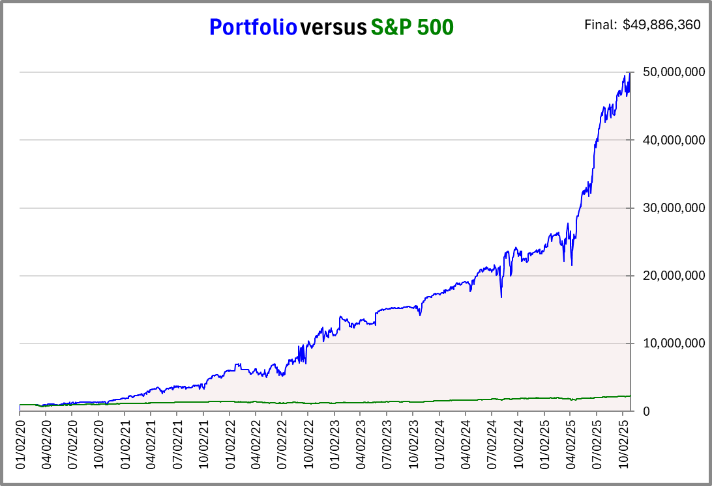
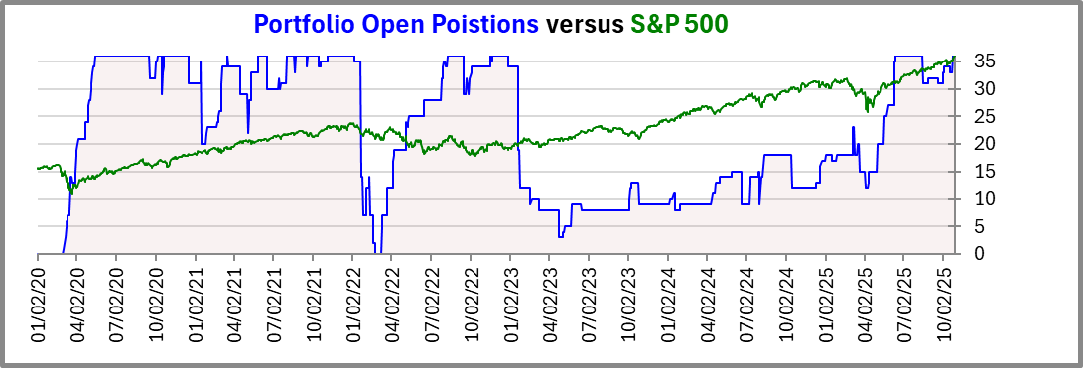
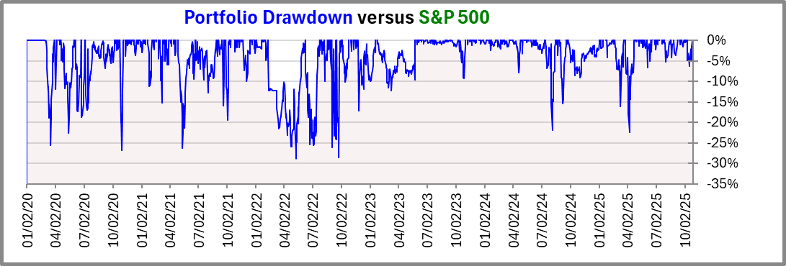
Summary.xlsm
This excel file is a summary of all the manual and automatic optimizations
It includes “Optimization No-Yes-No” tab which is using Rank by annual risk = True
It includes “Optimization Yes-No-No” tab which is using Rank by risk reward = True
It includes “Charts” tab which can load a log file of “simulate_yuda.py” and create a plot of the results:
logs/2025-11-27 09-36.log

Slide 15
Log file: Rules
📊 Account Simulation Rules
|----------------------------|----------------|
| Parameter | Value |
|----------------------------|----------------|
| Start Date | 01/01/2020 |
| End Date (Early Exit) | 10/28/2025 |
| Initial Cash | $ 1,000,000.00 |
| Max Puts/Account | 36 |
| Max Puts/Stock | 7 |
| Max Puts/Day | 5 |
| Wrapper Sweep +/- Step % | 3.0000% |
|----------------------------|----------------|
🧩 Entry Underlying Stock Rules
|----------------------------|----------------|
| Parameter | Value |
|----------------------------|----------------|
| Min 5-Day Rise | -19.75% |
| Min Above Avg | -4.39% |
| Max Above Avg | 41.00% |
| Min 10-Day Avg Slope | -0.1010% |
| Min Stock Price | $ 27.96 |
|----------------------------|----------------|
📈 Entry Put Position Rules
|----------------------------|----------------|
| Parameter | Value |
|----------------------------|----------------|
| Min DTE | 50 |
| Max DTE | 260 |
| Min Put Bid Price | $ 3.2517 |
| Min Put Delta | -25.0000% |
| Max Put Delta | -1.0000% |
| Max Bid-Ask Spread | 55.4300% |
| Min Avg Above Strike | -3.4000% |
| Min Risk/Reward Ratio | -11.0250 |
| Min Annual Risk | -15.3000 |
| Min Rev Annual Risk | -8.0000 |
| Min Expected Profit | -100.0000% |
| Rank By Risk/Reward Ratio | Yes |
| Rank By Annual Risk | No |
| Rank By Rev Annual Risk | No |
| Rank By Expected Profit | No |
|----------------------------|----------------|
📉 Exit Put Position Rules
|----------------------------|----------------|
| Parameter | Value |
|----------------------------|----------------|
| Position Stop Loss | 9999.0000% |
| Stock Below SMA150 | 17.8560% |
| Stock Min Above Strike | -9999.0000% |
| Stock Max Below Entry | 26.6000% |
| Min Gain to Take Profit | 9999.0000% |
|----------------------------|----------------|
💰 Trading Parameters
|----------------------------|----------------|
| Parameter | Value |
|----------------------------|----------------|
| Commission/Contract | $ 0.6700 |
| Max Premium/Trade | $ 27777.7778 |
|----------------------------|----------------|

Slide 16
Log file: Results
--- YEARLY PORTFOLIO GAIN ---
| Year | Total Value EOD | $ Total Gain | % Gain | % SPY Gain |
|---------|--------------------|----------------------|---------|------------|
| 2020 | $ 1,966,294.73 | $ 966,294.73 | 96.63% | 17.24% |
| 2021 | $ 6,009,637.25 | $ 4,043,342.52 | 205.63% | 28.73% |
| 2022 | $ 10,758,445.11 | $ 4,748,807.86 | 79.02% | -18.18% |
| 2023 | $ 16,548,662.91 | $ 5,790,217.80 | 53.82% | 26.18% |
| 2024 | $ 22,516,679.16 | $ 5,968,016.25 | 36.06% | 24.89% |
| 2025 | $ 47,549,839.11 | $ 25,033,159.95 | 111.18% | 18.26% |
|---------|--------------------|----------------------|---------|------------|
| TOTAL (Years) | $ 46,549,839.11 |
--- TRADE EXIT STATISTICS (by Trade Event Count) ---
| Exit Reason | Exit Events | % of Total | Total Gain $ | Net Gain % |
|--------------------------------------|--------------|-------------|-------------------|------------|
| Expiration (ITM/Assigned) | 0 | 0.00% | $ 0.00 | 0.00% |
| Expiration (OTM/Max Profit) | 160 | 57.14% | $ 24,457,686.35 | 99.89% |
| Last day liquidation | 35 | 12.50% | $ 19,618,100.30 | 0.00% |
| StopLoss: Stock Below Entry Thres... | 22 | 7.86% | $ -1,338,885.94 | -5.68% |
| StopLoss: Stock Below SMA150 | 63 | 22.50% | $ 3,812,938.40 | 16.18% |
|--------------------------------------|--------------|-------------|-------------------|------------|
| Total Exit Trades Closed | 280 | 100.00% | $ 46,549,839.11 | N/A |
|--------------------------------------|--------------|-------------|-------------------|------------|
| Total Entry Events | 280 |

